Slide 1
Sparse Reward
Hung-yi Lee

Slide 2
Sparse Reward
Reward Shaping
Notes:
好好念書，candy

Slide 3
Reward Shaping
Take “Play”,
$$r_{t+1}=1,r_{t+100}=−100$$
Take “Study”,
$$r_{t+1}=−1,r_{t+100}=100$$
$$r_{t+1}=1$$

Slide 4
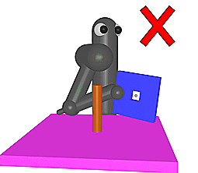
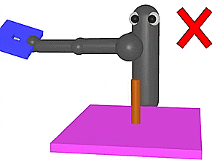
Reward Shaping
https://openreview.net/forum?id=Hk3mPK5gg&noteId=Hk3mPK5gg
VizDoom
Get reward, when closer
Need domain knowledge
https://openreview.net/pdf?id=Hk3mPK5gg

Slide 5
Curiosity
https://arxiv.org/abs/1705.05363
updated
updated
$$s_{1}$$
$$a_{1}$$
$$s_{2}$$
$$a_{2}$$
Env
Actor
Env
Actor
Env
……
$$s_{1}$$
$$a_{1}$$
$$s_{2}$$
$$a_{2}$$
$$s_{3}$$
Reward
ICM
Reward
ICM
$$r_{1}$$
$$r_{1}^{i}$$
$$r_{2}$$
$$r_{2}^{i}$$
$$R\left(τ\right)=\sum_{t=1}^{T}{r_{t}}$$
ICM = intrinsic curiosity module
$$+r_{t}^{i}$$

Slide 6
Intrinsic Curiosity Module
鼓勵冒險
$$r_{t}^{i}$$
Large reward if $s_{t+1}$ is hard to predict
$${\hat{s}}_{t+1}$$
diff
Network 1
Some states is hard to predict, but not important.
樹葉飄動
$$a_{t}$$
$$s_{t}$$
$$s_{t+1}$$

Slide 7
Intrinsic Curiosity Module
$$r_{t}^{i}$$
$φ$ is useful features related to actions
$$\hat{φ}\left(s_{t+1}\right)$$
diff
Network 2
Network 1
$$φ\left(s_{t}\right)$$
$$φ\left(s_{t+1}\right)$$
$$a_{t}$$
Feature
Ext
Feature
Ext
$${\hat{a}}_{t}$$
$$a_{t}$$
$$s_{t}$$
$$s_{t+1}$$

Slide 8
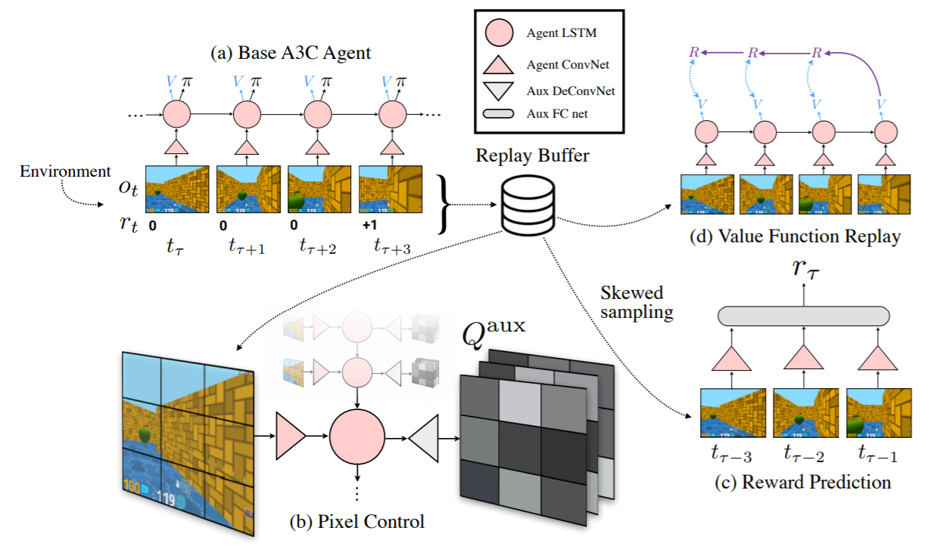
Reward from Auxiliary Task
https://arxiv.org/abs/1611.05397

Slide 9
Demo

Slide 10
Sparse Reward
Curriculum Learning
Notes:
http://bair.berkeley.edu/blog/2017/12/20/reverse-curriculum/

Slide 11
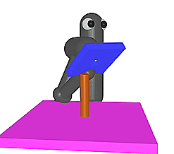
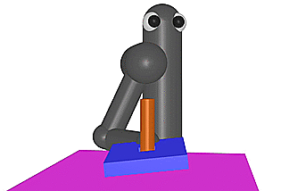
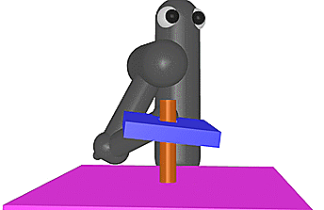
Curriculum Learning
Starting from simple training examples, and then becoming harder and harder.
VizDoom
Notes:
By choosing the ordering of the starting positions that we use in training, we can exploit this underlying structure of the problem and improve learning efficiency.

Slide 12
Reverse Curriculum Generation
$$s_{g}$$
$$s_{1}$$
Given a goal state $s_{g}$.
Sample some states $s_{1}$ “close” to $s_{g}$
Start from states $s_{1}$, each trajectory has reward $R\left(s_{1}\right)$
Notes:
“Start of Intermediate Difficulty” (SoID)

Slide 13
Reverse Curriculum Generation
$$s_{g}$$
$$s_{1}$$
$$s_{2}$$
Delete $s_{1}$ whose reward is too large (already learned) or too small (too difficult at this moment)
Sample $s_{2}$ from $s_{1}$, start from $s_{2}$
Notes:
“Start of Intermediate Difficulty” (SoID)

Slide 14
Sparse Reward
Hierarchical Reinforcement Learning
Notes:
層層負責

Slide 15
Hierarchical RL
下面這個例子純屬虛構，跟真實的狀況完全不同
校長
教授
菸酒生
provide goal
provide subgoal
action
If lower agent cannot achieve the goal, the upper agent would get penalty.
If an agent get to the wrong goal, assume the original goal is the wrong one.
https://arxiv.org/abs/1805.08180

Slide 16
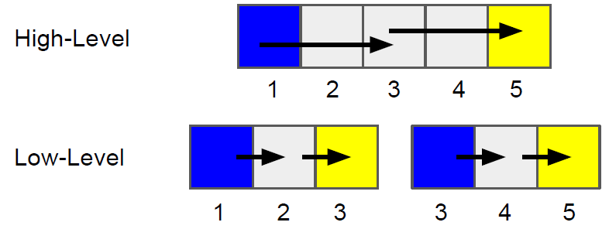
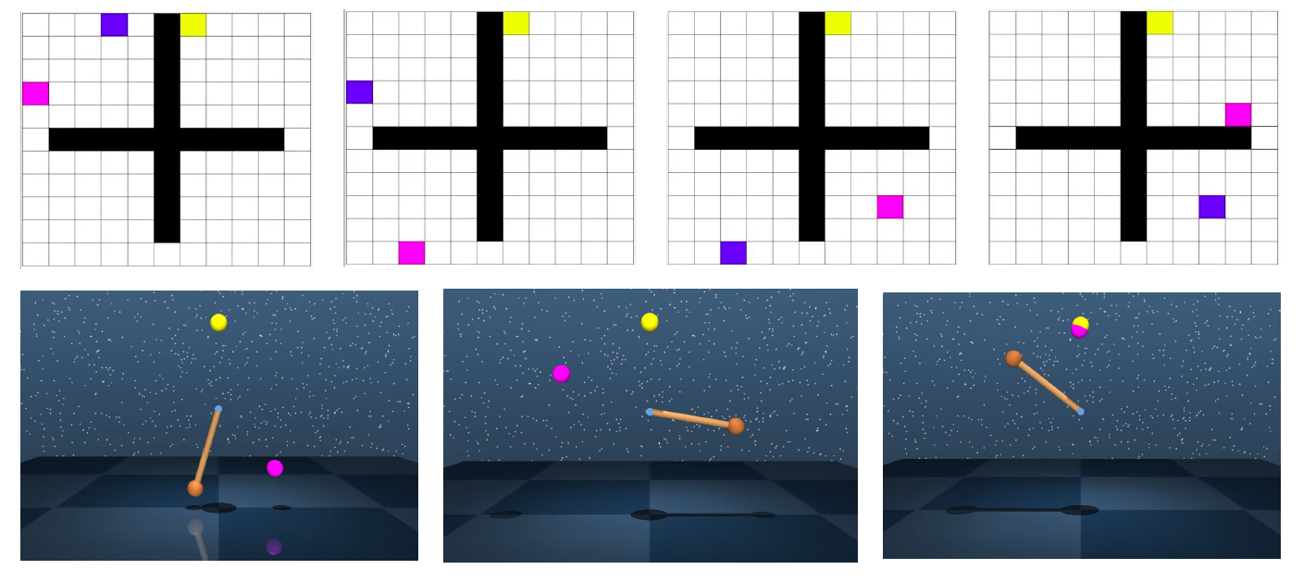
https://arxiv.org/abs/1805.08180
Notes:
後見之明

Slide 17
Acknowledgement
感謝芮祥麟博士發現課程網頁上拼字的錯誤

